Slide 1
MACHINE LEARNING BASED REAL TIME INTRUSION DETECTION SYSTEM
Hrithik Gaikwad 17101B0051
Suraj Balvanshi 17101B0066
Ashuthosh Bist 17101B0068

Slide 2
Introduction
Internet services have become essential to business commerce as well as to individuals. With the increasing reliance on network services, the availability, confidentiality, and integrity of critical information have become increasingly important. Enterprises are forced to fortify their networks against malicious activities and network threats.
No firewall is fool proof, and no network is impenetrable. Attackers continuously develop new exploits and attack techniques designed to circumvent your defenses. Many attacks leverage other malware or social engineering to obtain user credentials that grant them access to your network and data. A network intrusion detection system (NIDS) is crucial for network security because it enables you to detect and respond to malicious traffic.
The existing IDS have low detection rate, high false alarm rate and are unable to detect novel attacks. To overcome these problems, many researches are focused on utilizing Machine Leaning methods to discover abnormal patterns to improve Detection rate.

Slide 3
Problem Statement
Due to the exponential increase in volume of data, protection and security of such a sensitive information is major concern of organization. IDS being an of the important security tools to fight against such malicious activity. But the traditional IDS alarm report of intrusion to network and detection accuracy gets reduced with such a large network monitoring chuck data. This is one of the major issues when the system encounters unknown attacks or zero-day attack. Due to this, IDS has decreased accuracy rate and to Increased false alarm rate.

Slide 4
Scope
The goal of this project is to analyze and study various Machine Learning Algorithms and traditional IDS.
And design IDS using Machine Learning to improve detection rate, reduce false alarm rate and a system with a better capability of distinguishing attacks from normal packets.
The model will be integrated with a User Interface (UI) which will provide a more user-friendly way to monitor the network activity.

Slide 5
Aim & Objectives
Study and analyze various Machine Learning and Deep Learning Algorithms:
Study working of IDS and Network:
Building network monitoring tool (IDS)
Improving Security with integrating Machine Learning in IDS
Design a GUI for end user:

Slide 6
LITERATURE SURVEY
Intrusion detection is on a very first step of classification. They might want to distinguish the smallest conceivable pattern of data which can help identify the type of connection. Their idea of utilizing data gain to distinguish between the connection. We likewise depict momentarily the ideas of machine learning procedures which can be utilized to detect attack [4].
In this paper during their pre-processing stage, they utilize a packet sniffer, which is worked with Jpcap library, to extricate network packet data. packet data is divided by associations between each pair of IP. This classification stage comprises of two parts which are preparing and testing network information with Machine Learning. In the classification stage, they trained the chose AI calculation as an IDS model by utilizing a bunch of network records with realized answer classes. Considering the prepared IDS model, the grouping strategy can arrange the information in each record into ordinary network movement or fundamental assault types [1].

Slide 7
Literature Survey
This paper has shown that high accuracy might be kept up while decreasing bogus positives utilizing the proposed model made out of SVMs, decision trees, and Naïve Bayes. To start with, the SVM is prepared binary characterization added to the dataset to indicate if the case is an attack or normal traffic. Second, attack traffic is steered through a choice tree for grouping. Third, Naïve Bayes and the choice tree will at that point vote on any unclassified attacks. Future work is to compose this model as a Java class with the end goal that it very well might be applied in different systems or applications [2].
We came across a paper which uses snort which act has an open sources network monitoring tool scan network with and stores it into a database and use machine learning to help in detection of DoS attack they use classification and different algorithm and use best model fit for the outcome[5].

Slide 8
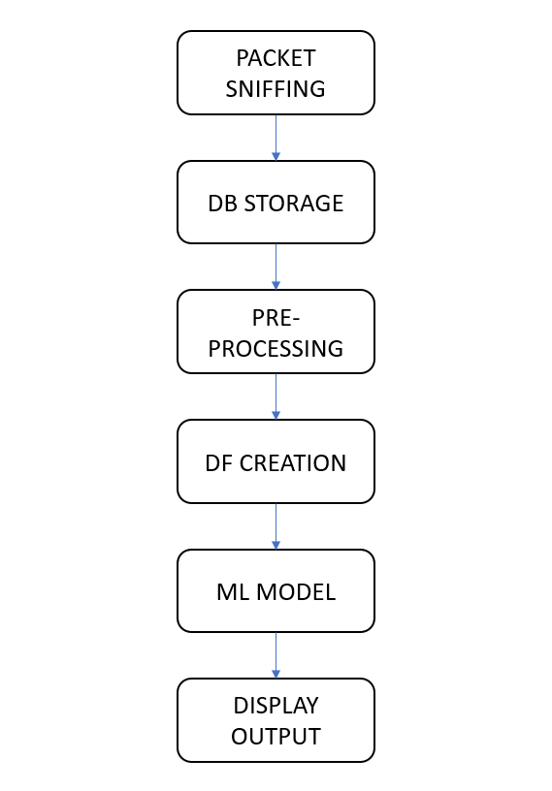
Proposed Methodology
1st Phase (Packet sniffing) starts with network packet sniffing program which is return in python. The network packets which are sniffed are formatted respective with source IP addresses, destination IP address, protocol name and network features.
2nd Phase (DB Storage) in this phase the network packet sniffed is in raw form. We extract the required information and push this data in a Database for further pre-processing.
3rd Phase (Pre-processing) in this phase, the network packets are aggregated based on Source IP address and Destination IP address and these packet data will be fetched from the database.

Slide 9
Proposed Methodology
4th Phase (DataFrame Creation). This aggregated data in DataFrame will represent the network traffic flowing through the host’s end. This DataFrame becomes the input for the Machine Learning model which is the 3rd phase (ML model).
5th Phase has two sub phases A) Training: Here Machine Learning model which is trained on previously captured data by sniffer program. B) Implementing: The trained SVM model is used to predict whether its and attack or not and a new column is attached.
6th Phase (GUI): The model results are displayed on GUI which is built on python Tkinter. Were the attack packets are classified as red and normal packets are shown colorless.

Slide 10
System Design
Packet Sniffing Design
This is the most important part of the project. Here we use python programming language and build a sniffer which will scan to the network using socket in every 2 second. Here the received network packets are in a raw form. The raw packet data is process to get the header information of packet. This header information is in binary bits format, which are then converted to decimal number format using string manipulation and this decimal number conversion and the result is passed to an if else condition to extract the required data and store it in SQL data base for pre-processing.

Slide 11
System Design
GUI
Python has its own library viz. Tkinter. Tkinter is provide a basic GUI functionality which fulfil the system need. The GUI, of the program contains separate frames for Control Buttons and the Connection Table. Control Buttons will change the value of global flag which determines whether to run sniffer or not. Connection Table displays the data of ongoing traffic though the machine.
When the ML program classify the network packets as attack, it turns the corresponding connection red colour to notify end user.

Slide 12
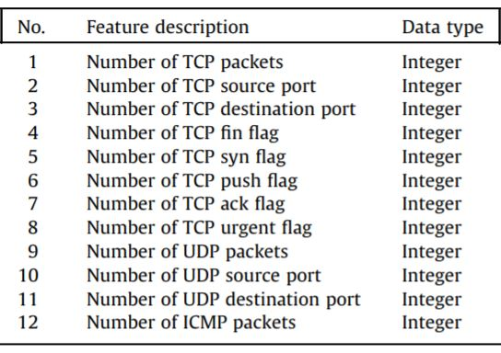
Machine Learning
Dataset Creation
We use a packet sniffer to scan the network packet to get information including IP header, TCP header, UDP header, and ICMP header from each packet. This packet information is partitioned and aggregating between each and every pair of IP address (source IP and destination IP) and forms the record in every 2 sec.
Each record key value of data features considered as signature features representing the main characteristics of network data and activities. We performed use find key features that define the signatures of normal and. attack network traffic.

Slide 13
Machine Learning
We select 12 essential features for our RT-IDS approach. The features along with the data type and the information gain value. We run sniffer program for 6 continues days to collect all the normal packets and attack data. The data collected was formatted and stored in a combined csv. This csv data is used to train ML model. The following table entries are extracted from network.

Slide 14
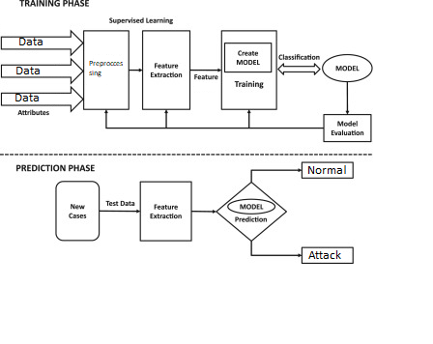
Machine Learning

Slide 15
Machine Learning
We have used SVM model to design are Machine learning model. A support vector machine (SVM) is a supervised machine learning model which is used for classifying result in two-group in classification problems. Here SVM is uses to predicts whether the packet scanned is normal or attack. There are 2 part in Machine Learning implementation which are Training and Testing Phase.
Training Phase: In this Phase we use 3 attack tools Etthercap, Synflood metaspoilt console and hulk phase to create dataset. The total table entries with noted were 34564. Where 11821 normal label entries and 23643 attack label entries, is given to the SVM ML model for training.
Prediction Phase: Trained ML model is use to predict result on unknown tool to see if it can accurately predict attack

Slide 16
Results
We have successfully developed a program the sniffs packet from the host machine, stores the packet data with the corresponding information into the database. This data contains IPv4 TCP, UDP and ICMP information.
The ML model was accurately able to distinguish between normal and attack pacts with 97.34% accuracy with known and unknown dos attack tool respectively the accuracy didn’t drop.
Table 1. SVM Results
SVM | Precision | Recall | F1
 | 0.9423 | 0.9543 | 0.9435

Slide 17
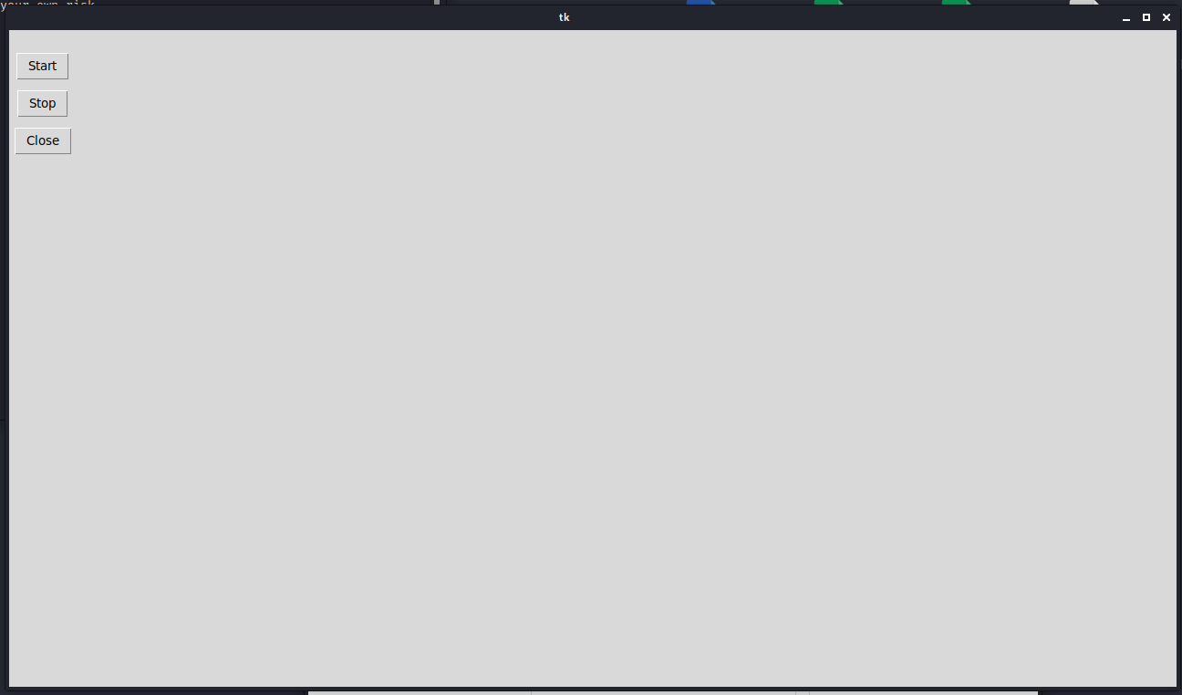
Application Screenshot
Figure 6.1.1: Home Page

Slide 18
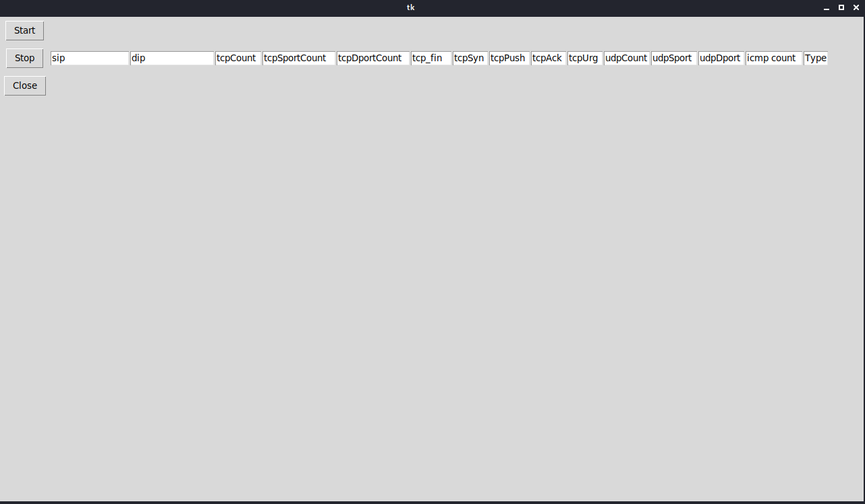
Application SS-2
Figure 6.1.2: Table Creation

Slide 19
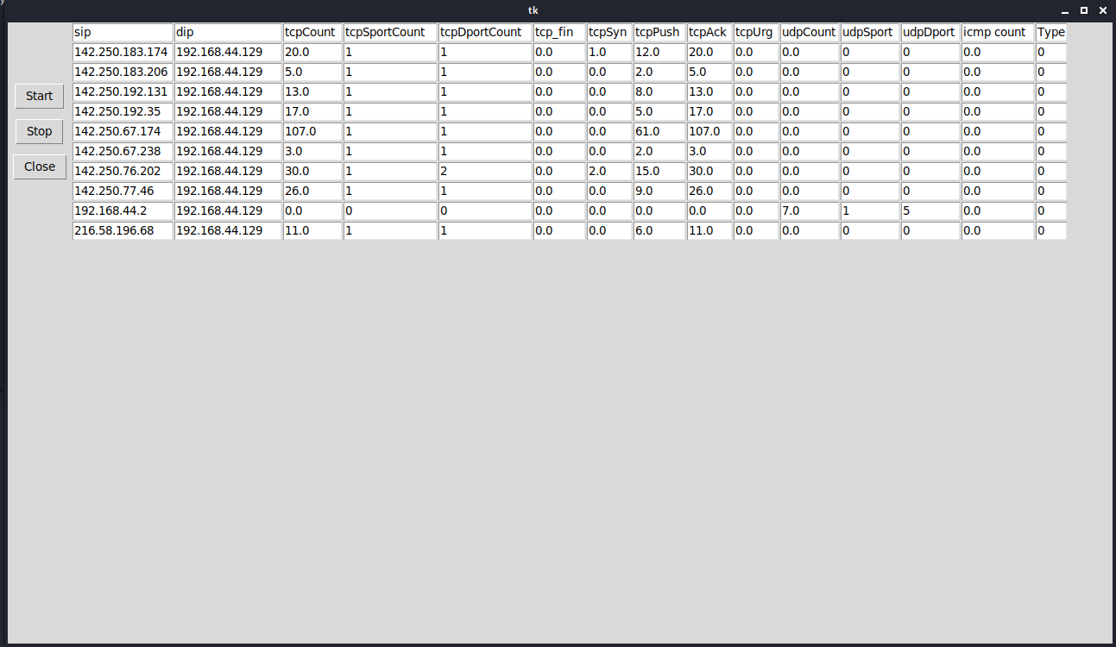
Application SS-3
Figure 6.1.3(a): Connection Display

Slide 20
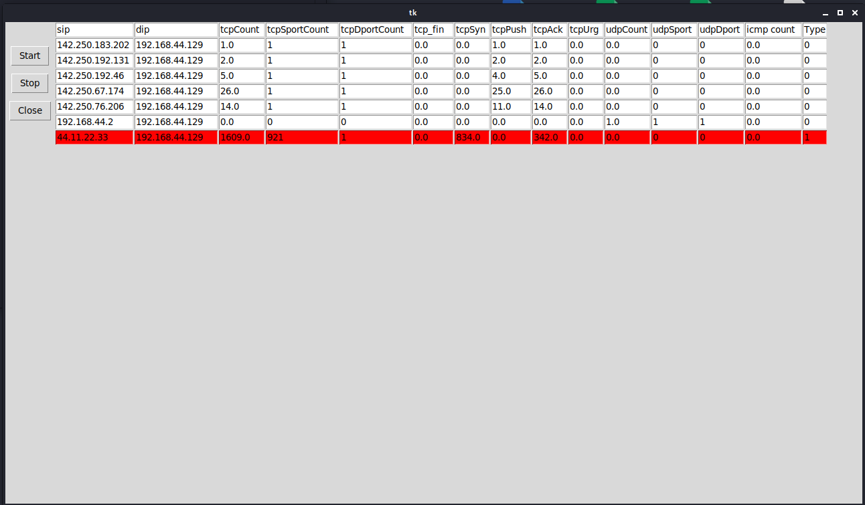
Application SS-4
Figure 6.1.3(b): Prediction Of Attack

Slide 21
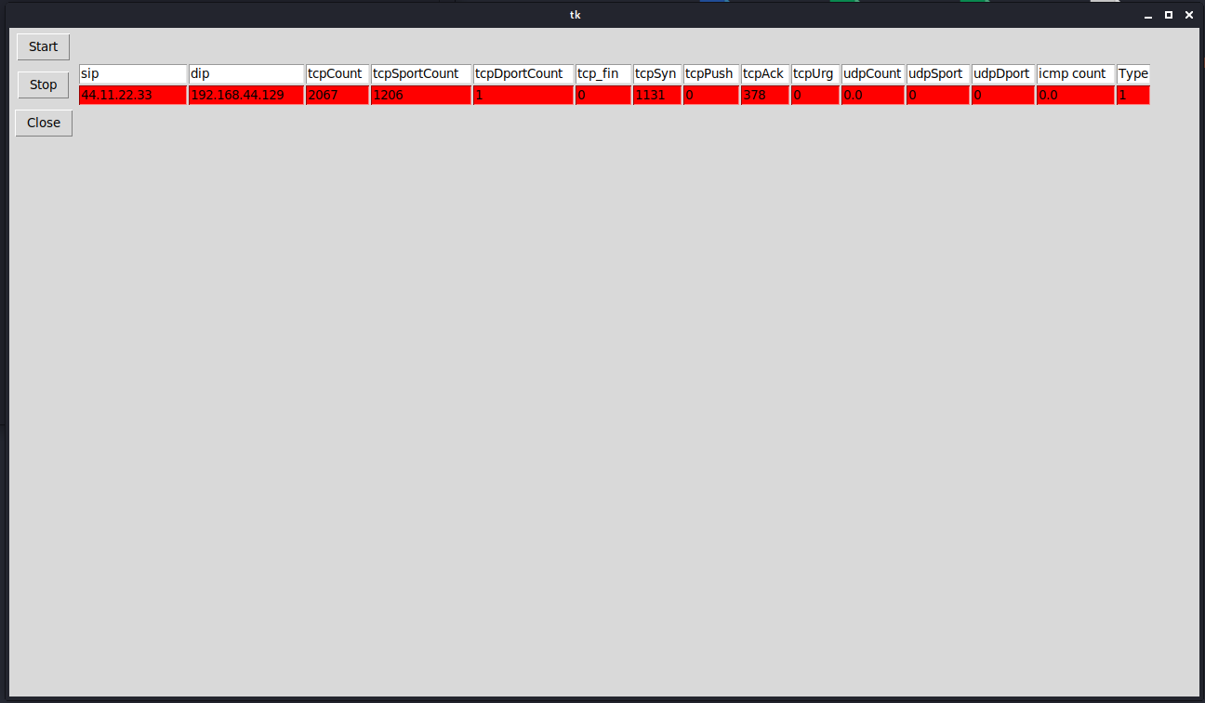
Application SS-5
Figure 6.1.4(a): Attack Packets Display

Slide 22
Conclusion
We presented a practical and efficient real-time network intrusion detection system (RT-IDS) model which can be used with existing well-known machine learning algorithms. Our. RT-IDS model consists of three phases: the pre-processing phase, the classification phase, and the post-processing phase. We also presented how we preprocess the network packet header data into records of 12 essential features. We present an uncomplicated IDS model which can be easily applied with existing machine learning technique. We propose 12 essential features which are relevant to DoS. This small number of features can significantly improve the on-line (real-time) IDS detection speed and consumption of computer resources. We present a practical real-time, network-based IDS that not only can efficiently detect but also can classify network data into two categories which are normal and Denial of Service(DoS)

Slide 23
Future Scope
We plan to implement a combination technique for misuse detection and anomaly detection with the proposed 12 relevant features in order to better detect unknown attack types as and on different Probe attack.

Slide 24
REFERENCES
[1] PHURIVIT SANGKATSANEE, NARUEMON WATTANAPONGSAKORN, CHALERMPOL CHARNSRIPINYO, 2011. Practical real-time intrusion detection using machine learning approaches. Computer Communications, Volume 34, Issue 18, Pages 2227-2235, ISSN 0140 3664.
[2] K. GOESCHEL, 2016. Reducing false positives in intrusion detection systems using data- mining techniques utilizing support vector machines, decision trees, and naive Bayes for off-line analysis. SoutheastCon 2016, Norfolk, VA, pp. 1-6, doi: 10.1109/SECON.2016.7506774.

Slide 25
Reference
[3] B. ZHANG, Y. YU AND J. LI, 2018. Network Intrusion Detection Based on Stacked Sparse Autoencoder and Binary Tree Ensemble Method. 2018 IEEE International Conference on Communications Workshops (ICC Workshops), Kansas City, MO, pp. 1-6, doi: 10.1109/ICCW.2018.8403759.
[4] LIU, H., LANG, B., 2019. Machine Learning and Deep Learning Methods for Intrusion Detection Systems: A Survey. Appl. Sci. 2019, 9, 4396.
[5] Snort-Based Smart and Swift Intrusion Detection System Indian Journal of Science and Technology,Vol 11(4), DOI: 10.17485/ijst/2018/v11i4/120917, January 2018ISSN (Print) : 0974-6846 ISSN (Online) : 0974-5645

Slide 26
Reference
[6] KUNAL AND M. DUA, 2019. Machine Learning Approach to IDS: A Comprehensive Review. 2019 3rd International conference on Electronics, Communication and Aerospace Technology (ICECA), Coimbatore, India, pp. 117-121, doi: 10.1109/ICECA.2019.8822120
[7] HALIMAA A. AND K. SUNDARAKANTHAM, 2019. Machine Learning Based Intrusion Detection System. 2019 3rd International Conference on Trends in Electronics and Informatics (ICOEI), Tirunelveli, India, pp. 916-920, doi: 10.1109/ICOEI.2019.8862784.
[8] V. V. KUMARI AND P. R. K. VARMA, 2017. A semi-supervised intrusion detection system using active learning SVM and fuzzy c-means clustering. 2017 International Conference on I-SMAC (IoT in Social, Mobile, Analytics and Cloud) (I-SMAC), Palladam, pp. 481-485, doi: 10.1109/ISMAC.2017.8058397.

Slide 27
THANKING YOU

